Slide 1

Department of Computer Engineering Atharva College of Engineering Mumbai.
FURNITURE E-COMMERCE STORE BASED ON AUGMENTED REALITY
Presented By
Syamantak Dhavle
Mohammad Qais
Khan Mohd Saif
Guided By
Prof. Bhavna Arora

Slide 2
Index
Abstract
Introduction
Aims and Objectives
Literature Survey
Problem Statement
Scope Of Project
Block Diagram
Implementation
Deployment
Prototype
Future Scope
Details of Hardware & Software used
Conclusion
References

Slide 3
Abstract
This app will be using augmented reality to implement detailed concept of furniture. The concept will be explained with the help of an app, which containing a lots of furniture based products. All the while involving the user to choose a different types of furniture as per their requirements. More functionality will be added in as the project progresses.

Slide 4
2) Introduction
The modern home decor and furniture lessens your stress after spending with a hectic schedule at the office. As vast changes have occurred in the furniture world, many innovative startups are accommodating to the huge demand.
In the beginning, except a few organized players like Home Stop, and HomeTown; none other brands in the furniture retail space have controlled to create a large chain of stores. But, a group of online furniture marketers has come out in the last few years, providing new business models for a company which is certain to grow as India’s middle-class broadens and spending hikes.

Slide 5
3) Aim and objectives
Aim: Our aim is to create the most realistic rendition of the furniture products present in the e-commerce store. We plan to import the objects created on
Android studio and create an app which includes an e-commerce store with AR functionality. This app will provide users with a more accurate representation of the said products and will reduce the rate of returns, thereby saving shipping costs.
Objectives-
Use of this application will enable the user to visualize how the furniture would look in the real world, offering preview of furniture in one’s real environment.
By the usage of this application, the furniture sellers can win competitive edge in the market.
It also aims to prevent revenue loss to the business, spoilt brand image of the store, customer attrition and deterioration of stakeholders’ interests as the customers can try visualizations of furniture placements in the available space before purchasing them.
It aims to put the sentence “What you see is what you get” in practice.

Slide 6
4) Literature Survey
Sr. No | Title | Author | Publication | Approach
1. | Augmented Reality Web Applications with Mobile Agents in the Internet of Things-IEEE 2014. | Teemu Lappanen, Arto heikkenen, Antti Krrhu. | IEEE 2014 | A mobile code-based approach for AR applications, based on battery-operated active tags containing links to the mobile code. When an AR tag is accessed, the code is downloaded using short-range communication protocol in AR.
2. | Research on the technology of LIDAR data processing. | Dekui Lv , Maolin Li, Xiaxin Ying, Yanjum Sui. | IEEE 2018 | LIDAR (Light Detection And Ranging) is described as a new high resolution earth space information technology, has the characteristics of short data production cycle, little influence by different weather, high degree of automation etc.
3. | ARKit and ARCore in serve to augmented reality | Zainab Oufqir, Abdellatif El Abderrahmani,Khalid Satori | ICSV 2020 | In this paper we understand the basic understanding about the open-source libraries to be used in building this project, their main features and functionalities for a better implementation in the real world.
4 | The Use of ARCore Technology for Online Control Simulations | Xiaochen Zhang, Yi Zhu; Xiaoyu Yao | Ieee March 2019 | In this work, we understand a developed technology, called assistive navigation system for visually impaired people (ANSVIP) that takes advantage of ARCore to acquire robust computer vision-based localization.

Slide 7
5) Problem Statement
Purchasing products for interior design is a challenging task.
The problem is concerned with the fact that the product cannot be put into its place before it is purchased.
Customers may wonder how the furniture would look in its tentative place, People end up buying furniture with incorrect dimensions, inaccurate colours or different designs from the ones that they see in the product images.
This creates a problem for customers as returns in such online stores is also a hassle and generally a bad idea, since it is not easy to ship furniture due to the high prices involved in shipping.
Visualizing the furniture in the real world can be made possible through Augmented Reality applications.

Slide 8
6) Scope of Project
The developed system has a wide range of applications. Due to the growth of the e-commerce platforms, the developed system has applications in a lot of sectors, especially in cities like Mumbai, Delhi and Bangalore. The application will provide any shopper a true sense of your product with augmented reality, which will provide a revolutionary way of shopping to any and all customers of the store..

Slide 9
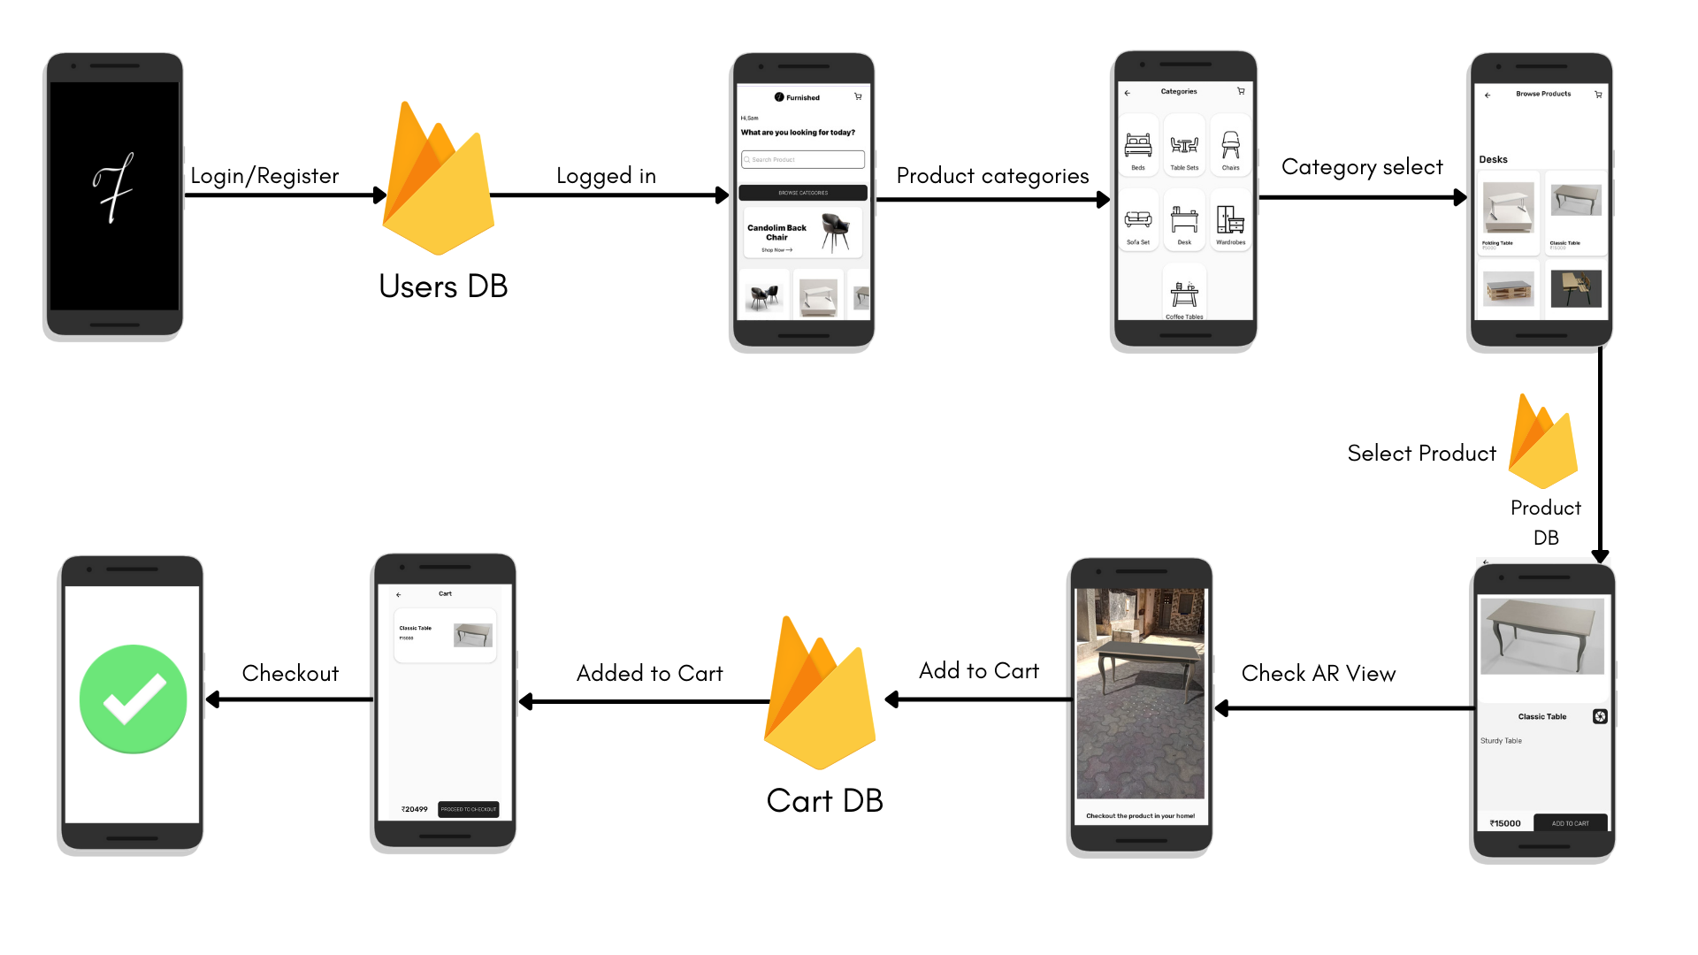
7.0) Block Diagram (User)

Slide 10
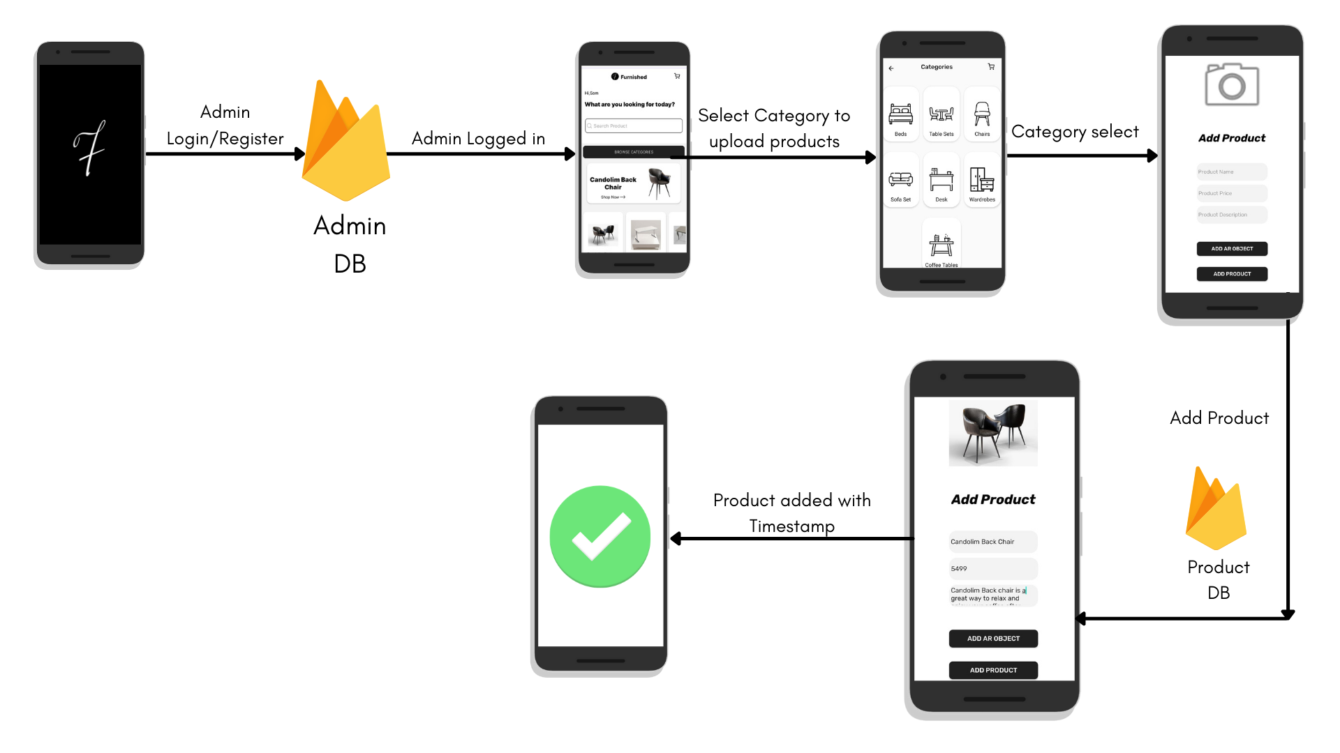
7.1) Block Diagram (Admin)

Slide 11
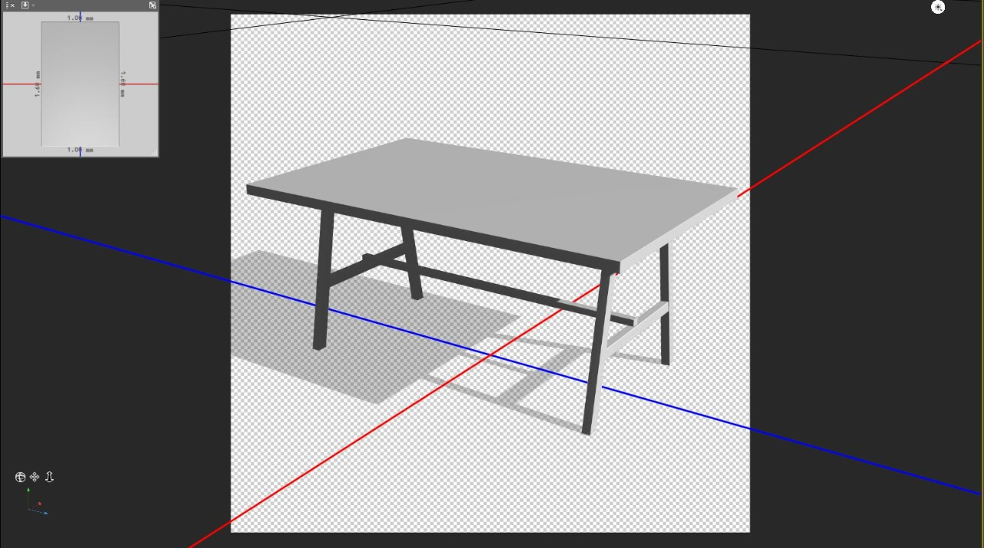
8) Implementation
Creation & Collection of 3d Models.
The models required for the application were created using c4d & some of them were collected from various sources.
The sceneform plugin uses GLB models, which can be rendered directly at runtime along with the textures unlike the FBX or OBJ formats.
Raw model of a table in C4d

Slide 12
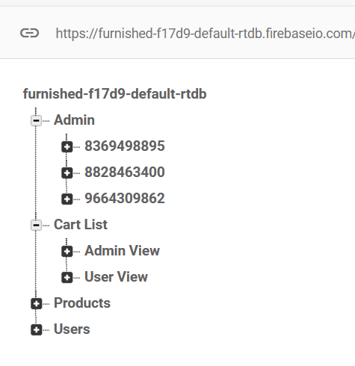
2) Database Creation on firebase
Database required for the application is created on the firebase platform. The structure of the database is given below-
This realtime database consists of 4 Parent nodes.
The Admin node consists of the users who have the permission to upload any product data.
The products node consists of the product name, description & price.
The users node contains the data of the customers accessing the app.
The Cart List database consists of the data about the products added to cart by any user.
All of the products consists of a unique product id, which is the timestamp of when the products were added to the database, which allows to uniquely identify each product.
Along with this database, the product images and AR model GLB files are added to firebase storage, as they are not traditional database records to be added to a realtime database.

Slide 13
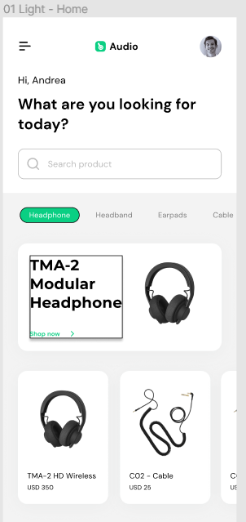
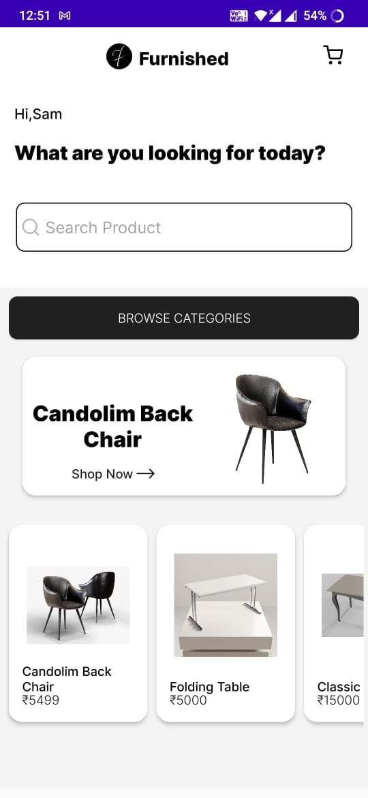
3.0) Creation of the User Interface
The user interface of the application was based on an open source project on Figma.
The design of the application was inspired by the project whole home page is present on the left
The final ui turned out pretty similar to the e-commerce ui project on figma, but there were certain changes made like the colour scheme and the font of the application
Further pages of the application can be found on the next slide.

Slide 14
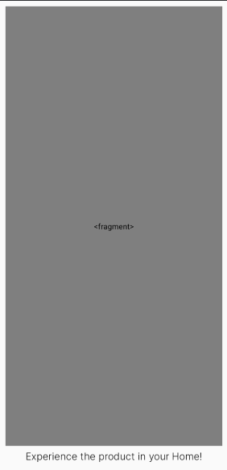
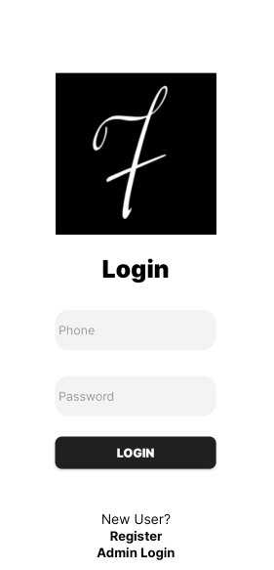
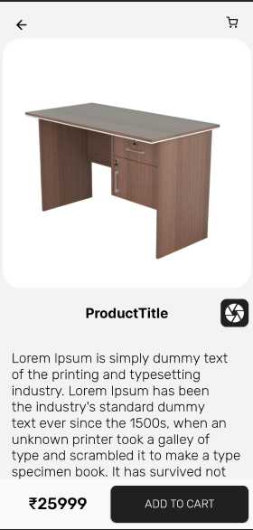
3.1) Creation of the User Interface
Login Page
Home Page
Product Description Page
AR Fragment
Page

Slide 15
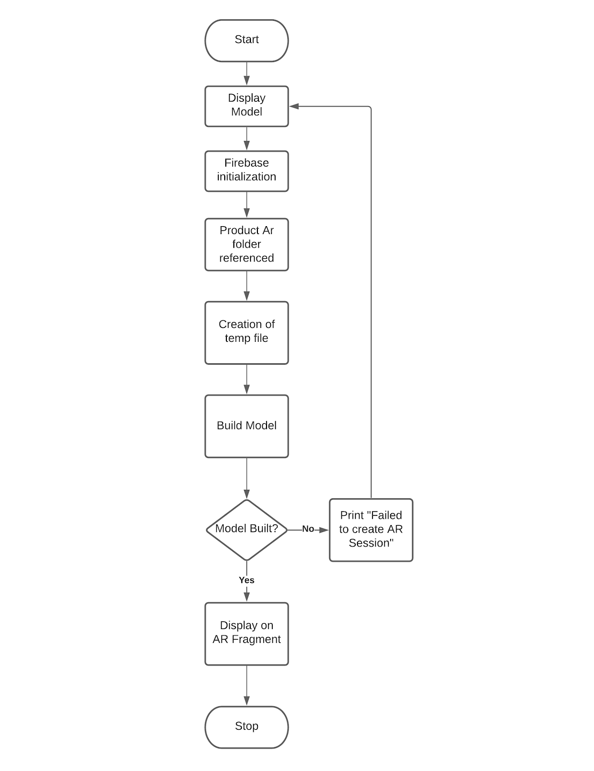
9) Deployment
9.0) Flowchart of AR session

Slide 16
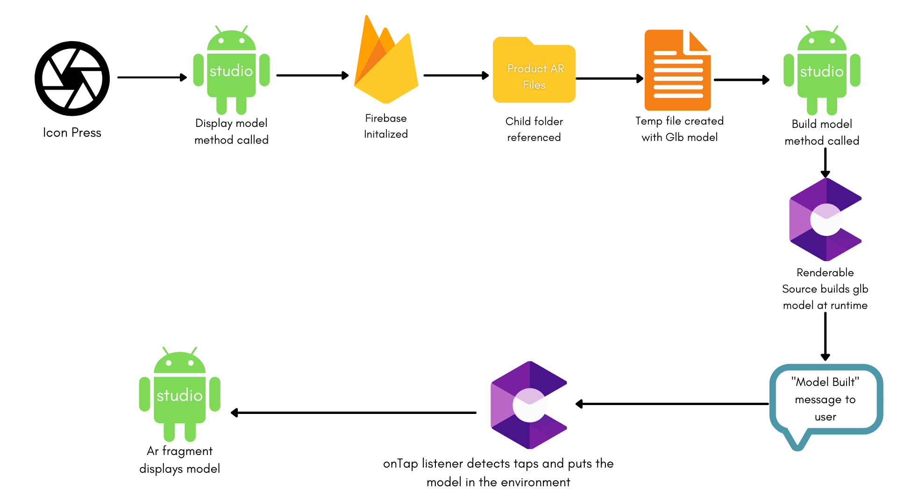
9.1) Block Diagram of AR session

Slide 17
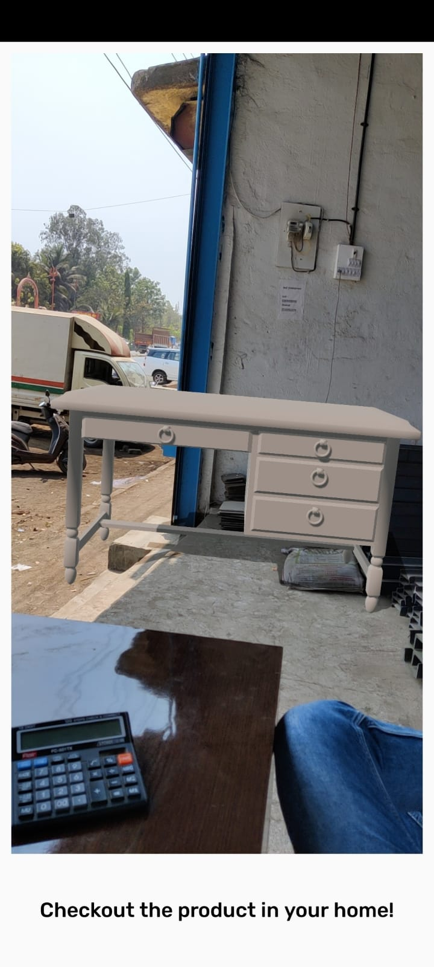
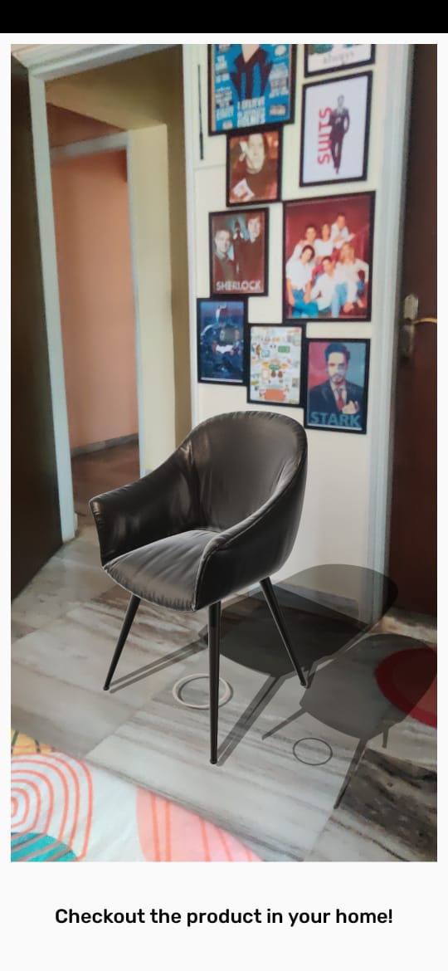
10) Prototype
The models used in this project are in the .gltf/.glb format, due to the following factors-
Compatible with sceneform
Model is built faster at runtime
Can be packed with textures and colours in the same file.
If .fbx or .obj models are used, they have a chance of appearing without their colours, like in the table image.
Table model (uncoloured)
Candolim chair GLB model

Slide 18
11) Future Scope
AR is currently used mostly for entertainment purposes, which is hardly using the technology to its full potential. This app is created to promote the use of AR in the field of business, thus it can be extended to a lot of other industries like Textiles, Aviation, Electronics etc.
The introduction of LIDAR sensor in iphone devices is a game changer for the mobile cameras industry, which also helps the growth of AR applications all around the world, and would increase this app’s compatibility with different types of devices.
A technique called photogrammetry is used to create 3d models with the highest complexity and quality. Though it is currently an expensive process, we hope that there are softwares built in the future which would enable this application to add 3d models to it with the best possible quality, which can be adapted by a lot of furniture store chains.

Slide 19
12) Details of Software and Hardware used
Software
Android Studio
Cinema 4d
Sceneform Plugin
ARCore Plugin
Figma (referred for UI)
Java JRE
Hardware-
The system will work on mobile devices, tablets, and AR compatible devices.

Slide 20
13) Conclusion
This app will let you see potential new furniture in your actual room using Augmented Reality. Just pick whatever item you are thinking of buying and tap on the camera. Point the camera wherever you are thinking of placing the furniture in the room and a life-size version will appear in that spot.

Slide 21
14) References
1. Augmented Reality Web Applications with Mobile Agents in the Internet of Things-IEEE 2014 | Authors:Teemu Leppänen; Arto Heikkinen; Antti Karhu; Erkki Harjula; Jukka Riekki; Timo Koskela
2. Research on the technology of LIDAR data processing: IEEE 2018 | Authors:Dekui Lv; Xiaxin Ying; Yanjun Cui; Jianyu Song; Kuidong Qian; Maolin Li
3. Using the unity® game engine as a platform for advanced real time cinema image processing: IEEE 2018 | Author:Timothée de Goussencourt; Pascal Bertolino 4. ARKit and ARCore in serve to augmented reality-IEEE 2020 | Authors: Zainab Oufqir; Abdellatif El Abderrahmani; Khalid Satori
5. Getting started with AR development in Unity :
https://docs.unity3d.com/Manual/AROverview.html
6. ARCore overview: https://developers.google.com/ar/discover
7. Top 6 e-commerce furniture sites in india :
https://www.business-standard.com/article/companies/the-top-6-online-furniture-ec ommerce-sites-in-india-115110401480_1.html

